Slide 1
Innovation Strategy
Lecture 5

Slide 2
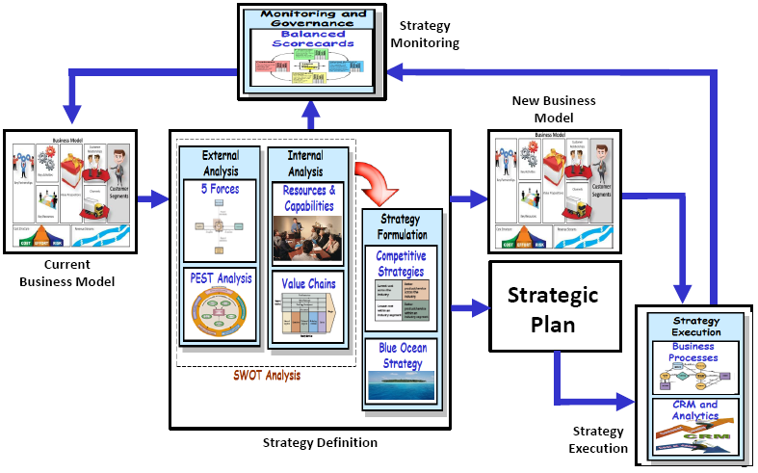
The Strategic flow

Slide 3
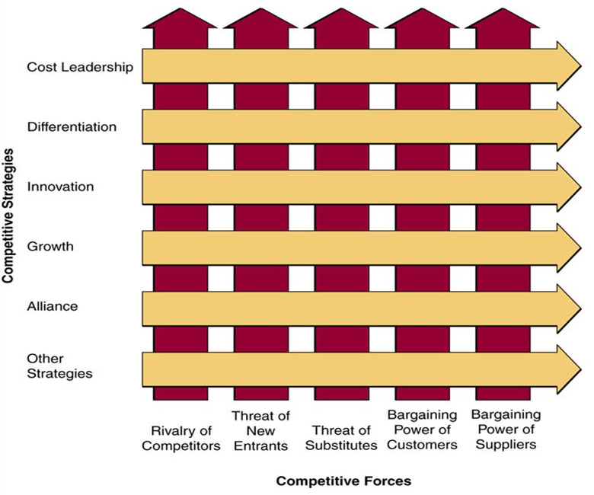
Porter’s competitive forces model

Slide 4
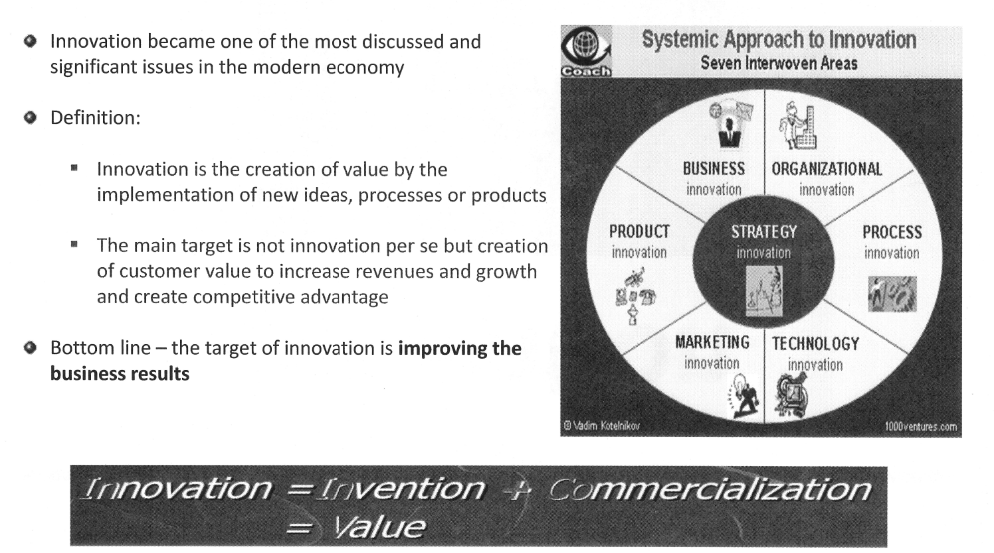
INNOVATION

Slide 5
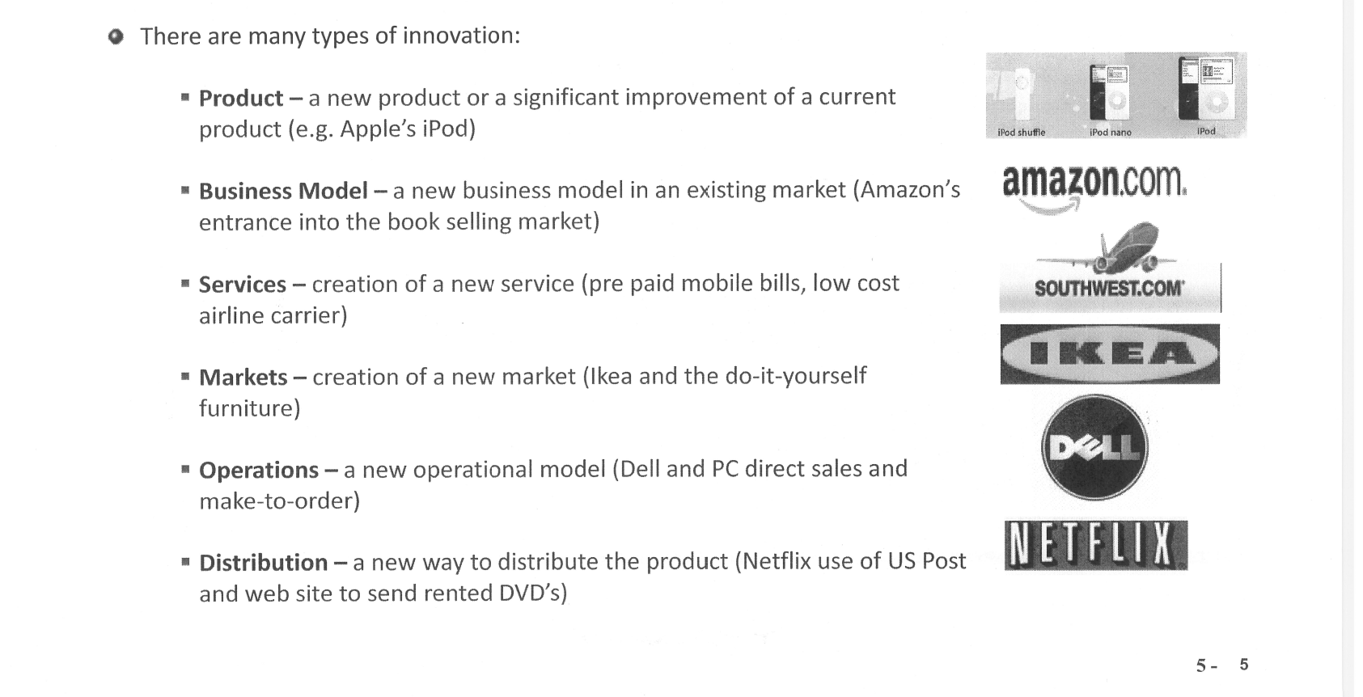
Types of Innovation
Notes:
s

Slide 6
Innovation degrees

Slide 7
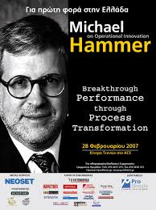
OPERATIONAL INNOVATION: BREAKTHROUGH PERFORMANCE THROUGH PROCESS TRANSFORMATION

Slide 8
OPERATIONAL INNOVATION advantages

Slide 9
Innovation dimensions

Slide 10
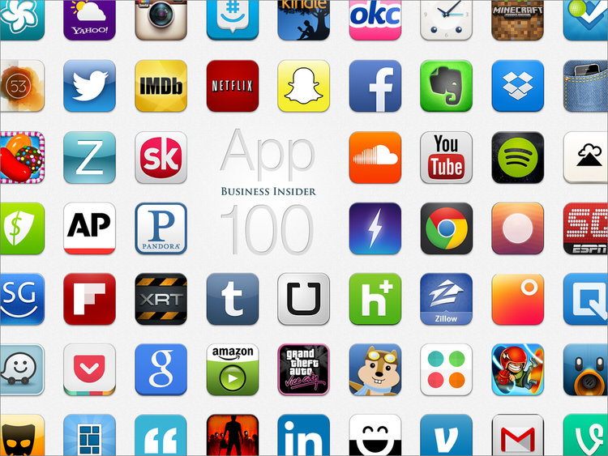
The new customer attitude
Customization – that’s the way I like it
Communities – I want to be part of
Multi channel – I’ll call, click or come to the store
Value for money – I want more value for my money
Choice – give more choices to select from

Slide 11
The traditional view of value creation

Slide 12
The basic transformation in value creation
Co-creation value

Slide 13
The new house of innovation
Value is based on unique, personalized experiences of consumers –focus on one consumer experience at a time, even if serving 100 million consumers
(N = 1)
No firm is big enough in scope and size to satisfy the experiences of one consumer at a time –access to global resources from a wide variety of other big and small firms
(R = G)
The resources of many to satisfy the needs of one

Slide 14
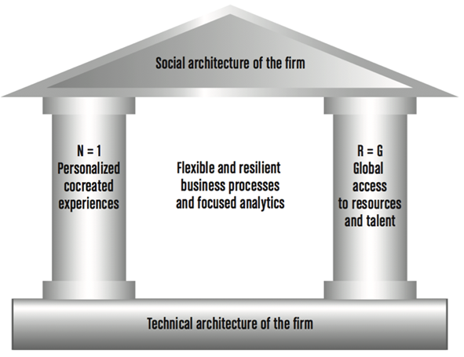
The new house of innovation

Slide 15
Experience Co-creation
individuals must be able to co-construct unique value for themselves through customer network interactions that facilitate contextualised experience outcomes through (DART)
Dialogue
Access
Risk management
Transparency (DART).

Slide 16
Experience Co-creation
Dialogue encourages not just knowledge sharing, but shared understanding between companies and customers. It also give individuals more opportunity to interject their views of outcomes of value into the value creation process.
Access to knowledge, tools and expertise helps individuals construct their own experience outcomes.

Slide 17
Experience Co-creation
Risk Management assumes that if consumers become co-creators of value with companies, they will demand more information about potential risks of goods and services, but they may also have to bear more responsibility for dealing with those risks.
Transparency of information in interaction processes is necessary for individuals to participate effectively in co-creation, and engender trust between institutions and individuals.

Slide 18


4 Ways IT Is Driving Innovation
Measurements
Innovation
Processes
Replication
Experimentation
Sharing
An Interview with Prof. Eric Brynjolfsson: The 4 Ways IT is Driving Innovation, MIT Sloan Management Review, The Intelligent Enterprise, April, 2010

Slide 19
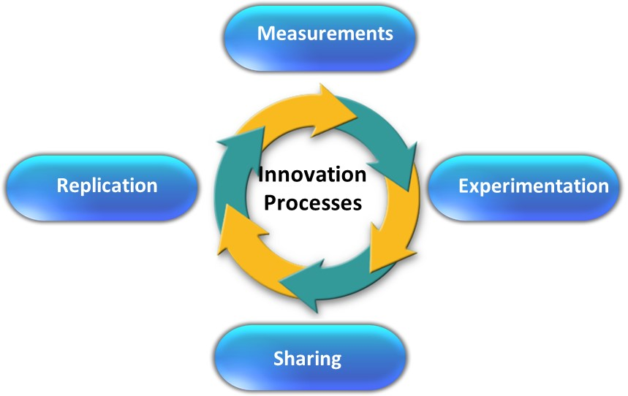
Measurement

Slide 20
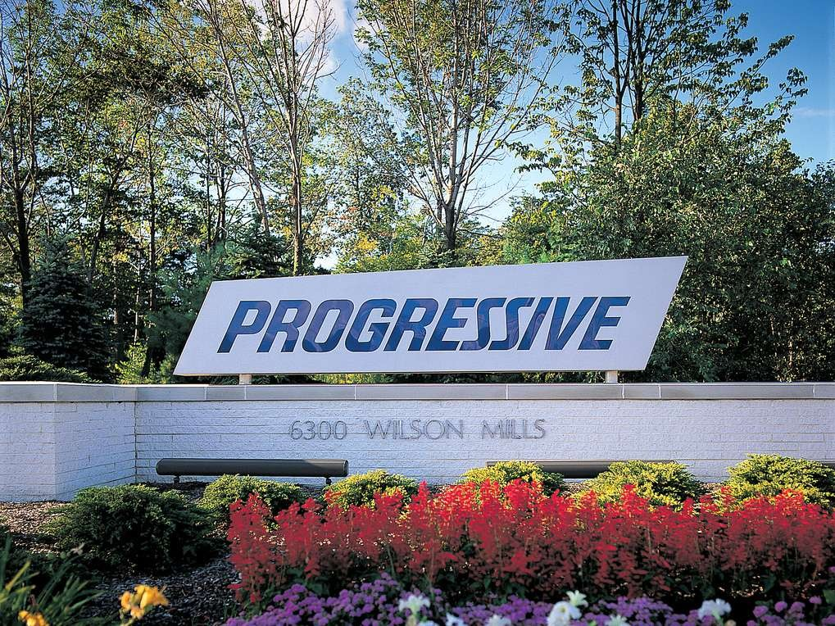
Progressive case study
3

Slide 21
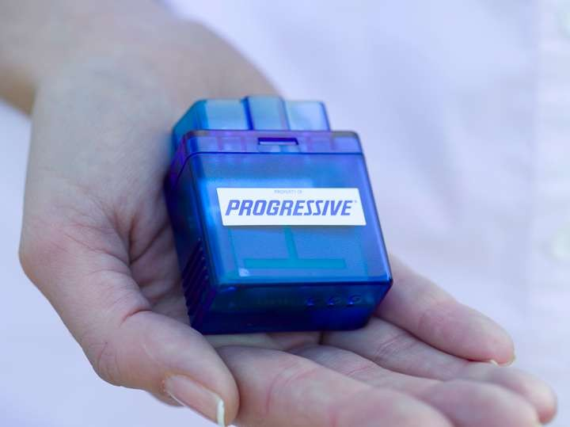
Progressive case study
13

Slide 22
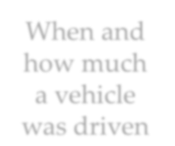















Progressive case study
premiums
on a pay-as-you-go basis.
When and
how much
a vehicle
was driven
GPS
satellites
Mapping
technology
Internal
computer
•
Tracking mileage, time of day and where driving
occurred.
• Example: A mile driven at 2 a.m. was four or five
times more expensive than one driven at 7 a.m.
14

Slide 23

Progressive case study
Dimension | Title | Description
Pricing to change risk behaviour | Switching from standard cover to a Telematics rated product | At Progressive.com, when automobile insurance customers purchase a standard insurance product, they are offered the option of installing a telematics recording box in their vehicle. The telematics recording box collects rich data on journey patterns and driver behaviour. Progressive’s machine-based rating engines determine the suitability of the driver for usage-based insurance and can calculate a usage-based premium to reflect their driving style. Labelled as their “SnapShot” program, there is an immediate incentive for customers to trial usage-based data collection as Progressive offers customers a 30% saving on insurance premiums after 31 days of trialling the Telematics recording box. In return, Progressive collects "free" data to analyse on a risk basis and for analysis across its whole portfolio. Progressive gets to decide if it wants to invite suitable customers to switch to a usage based product and pricing, or not.

Slide 24
Progressive case study

Slide 25
Progressive case study
Barriers to customers
• Higher Premiums for consumers who commute at night
• Monthly fee for the additional set of services (GPS-
based)
• Cost of installing GPS transponder, cellular system , etc.
• Lack of privacy
• Focus on new technologies, losing sight of the insurance
business

Slide 26
Progressive case study
advantages
• Market shares and global market
• Company's reputation
• Customers increase
• First-mover advantage

Slide 27
Progressive case study
disadvantages
• High costs and less reward
• Approval from each state
• Time duration
• High risk potential
• Liquidity issue

Slide 28
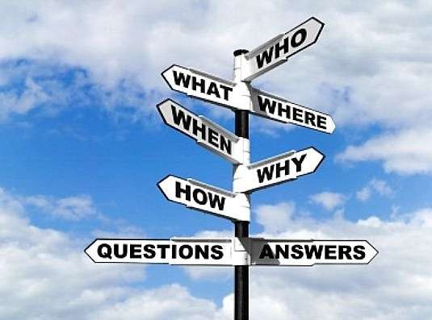
Progressive case study
Innovation dimensions

Slide 29
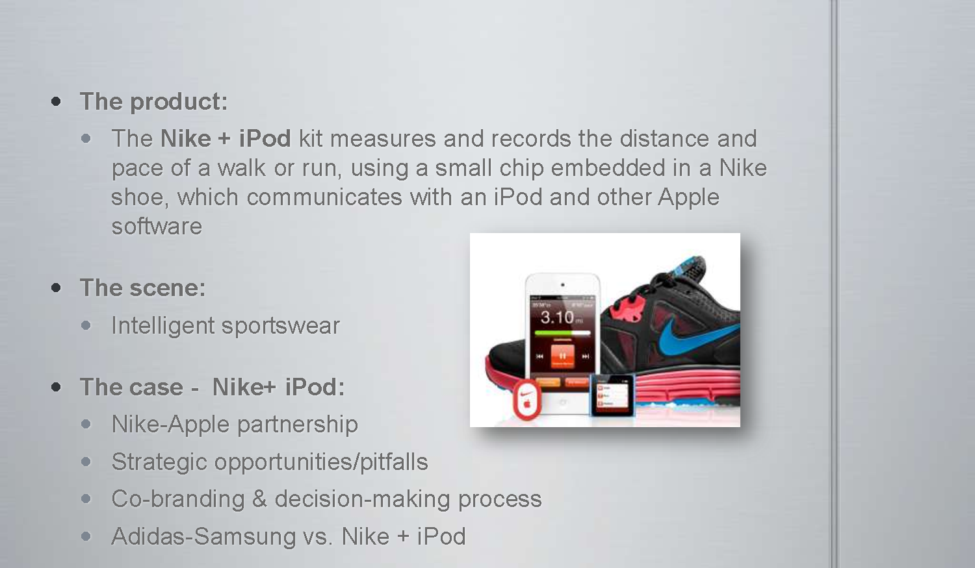
Nike-apple case study
Innovation dimensions

Slide 30
Nike-apple case study
Strategic
opportunities and pitfalls
?

Slide 31
Nike-apple case study
Both market leaders within their industry
Mutual interests – Life quality
Same type of customers
Brand synergy - both ways
Large joined customer base
75% of all runners already listen to music
A Nike crisis affects Apple and vice versa

Slide 32
Nike-apple case study
The Apple & Nike brands
Innovative
Market leaders
Large loyal customer base
Brand synergy
Distribution channels
Expansion of technology
High Product requirements
High priced
Expansion of technology
Potential harmful influences

Slide 33
Nike-apple case study
How does the co-branding
influences the
Consumers decision making
?

Slide 34
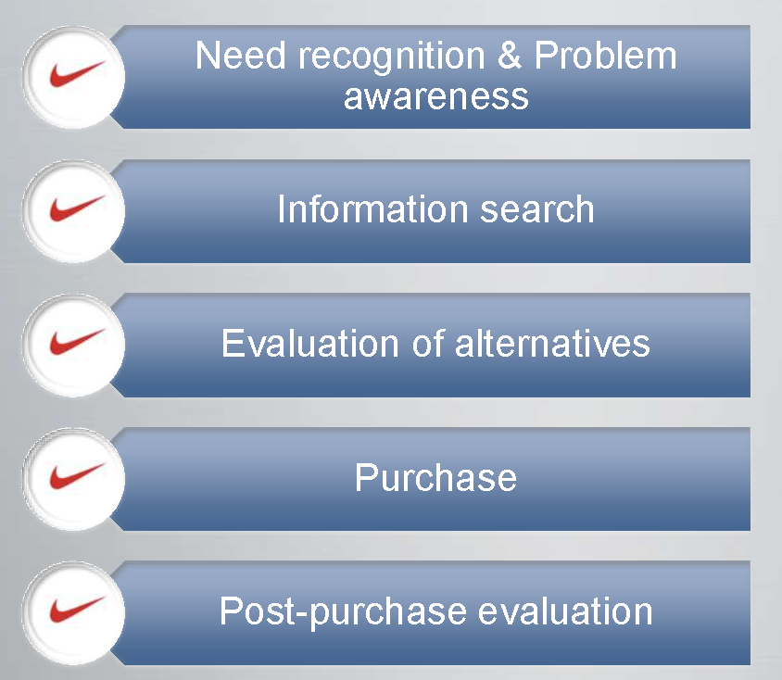
Nike-apple case study
5 stages model (kotler)
N = 1
R =G

Slide 35
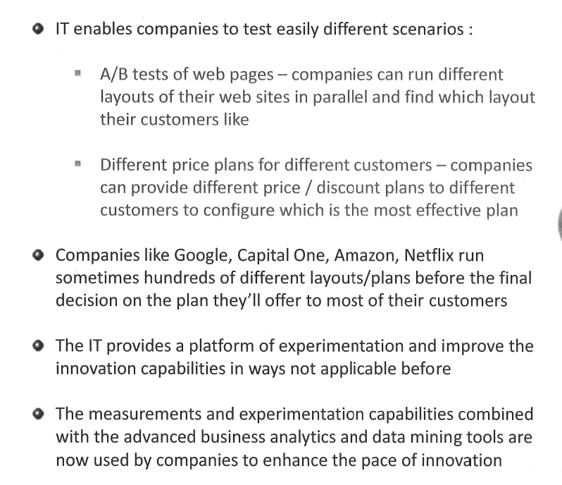
experiments

Slide 36


zipcar case study
ZIPCAR: SAVING THE WORLD ONE CAR AT A TIME

Slide 37
SWOT ANALYSIS
OPPORTUNITIES | STRENGTHS
Search for sustainable solutions | Zipcar lower impact than car ownership
Reduced spending | Zipcar lower cost than car ownership
Desire to improve quality of life | Zipcar usage improves overall quality of life

Slide 38



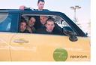
CUSTOMER CHARACTERISTICS
Derive great pleasure from using Sustainable products
Socially conscious – Zip Sharing
Save money by not owning a car
Heavily populated cities
Colleges

Slide 39
zipcar - case study

Slide 40
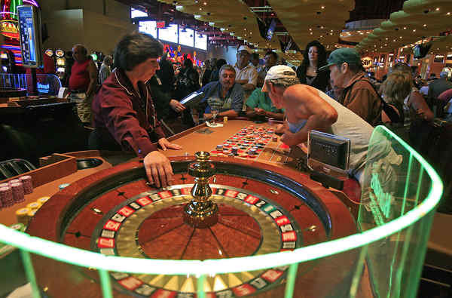
Harrah - case study

Slide 41
Harrah - case study
Harrah’s Entertainment analyzes customers to develop gambling profiles and identify most profitable customers:
New business program – to become loyal
Loyalty program – frequency upside
Loyalty program – Budget upside
Retention program

Slide 42
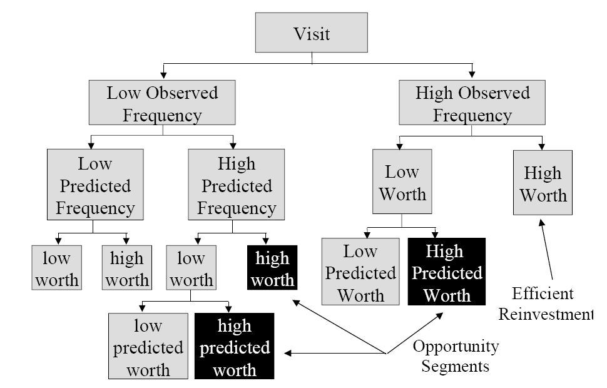
Harrah - case study

Slide 43
Harrah - case study
Principle tools include:
Software for database query and reporting
Online analytical processing (OLAP)
Data mining

Slide 44
Harrah - case study

Slide 45
Harrah - case study

Slide 46
SHARING

Slide 47
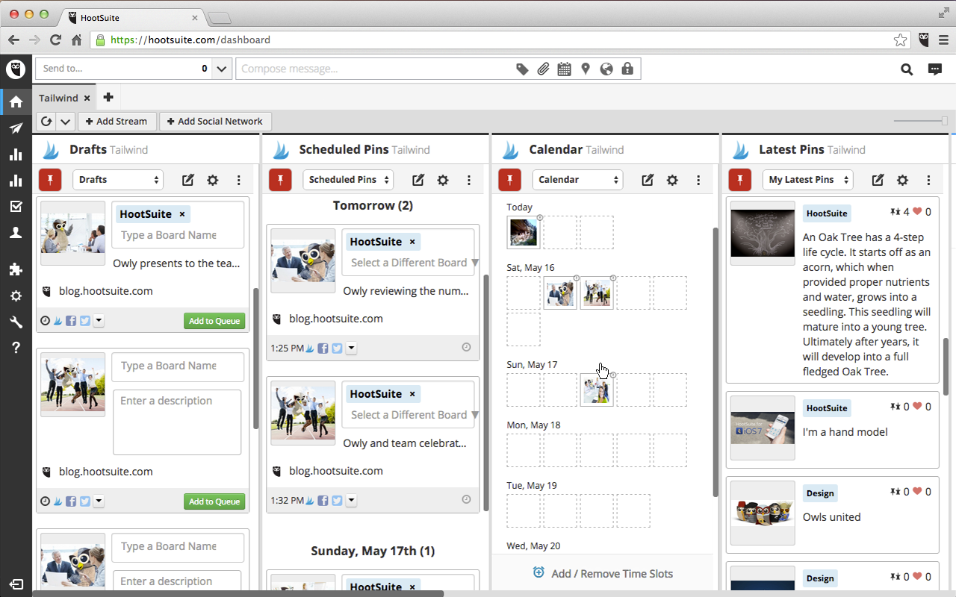
SHARING – HOOTSUIT CASE STUDY

Slide 48
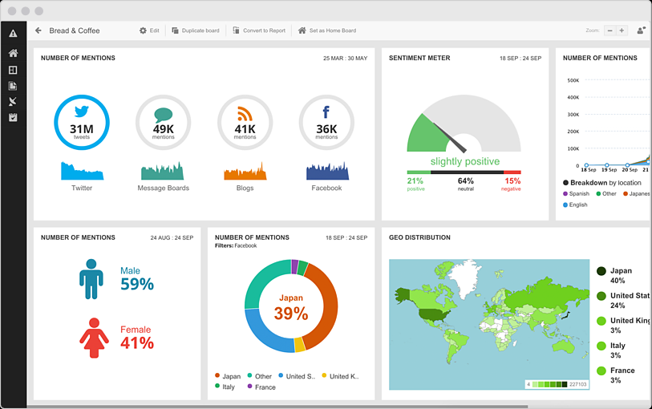
SHARING – HOOTSUIT CASE STUDY
Richer social listening. Smarter business decisions.

Slide 49
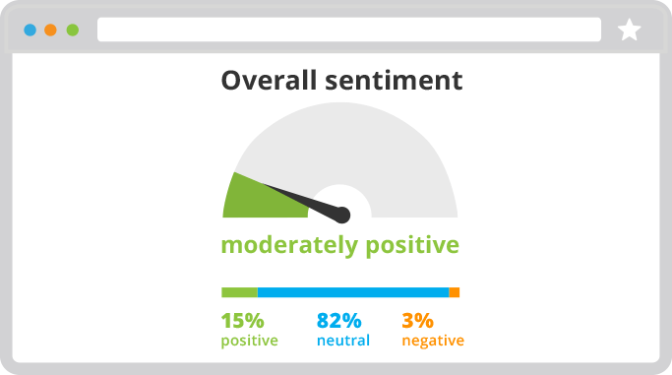

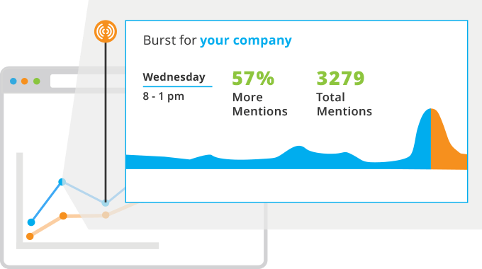
SHARING – HOOTSUIT CASE STUDY
Richer social listening. Smarter business decisions.
Gauge the social sentiment around your brand
Stop missing conversations that matter
Be the first to know when trends take off

Slide 50
REPLICATION

